Slide 1
AI-DOChelper
Guide : Group no : Group Members :
Prof. Aejaz khan 43 Vikrant Shah
Surbhi Singh
anuja kothavale

Slide 2
Introduction
For many years, many people have died due to undetected diseases. Early detection of these diseases at the micro classification stage can be useful for providing proper treatment to the patients at the early stage and could have saved a lot of lives. A lot of research is being done to detect these diseases at the earliest.

Slide 3
Problem Statement
AI-DocHelper, an artificial intelligence-based system.
The model that gives the best accuracy and minimum loss.
The output of Final result will be a prediction.

Slide 4
Requirements
Hardware Requirements :
Processor : Intel Core i3 / Pentium
RAM : 4 GB Minimum
Hard Disk Space : 30 GB Minimum

Slide 5
Requirements
Software Requirements :
Operating System : Windows / MacOS / Linux
Browser : Google Chrome / Mozilla Firefox
Software Libraries : Python 3.x, Tensorflow 2.0, Annaconda, Jupyter Notebook, Numpy, Pandas, Scikit-learn, Flask/Django

Slide 6
Features
Early detection of disease
User friendly GUI
Precise results
User Data Store

Slide 7
Why AI-DocHelper ?
Existing system available are able to detect only one or two diseases.
Everything in the future will be automated.

Slide 8
Proposed System : Workflow

Slide 9
Pre-Processing the Textual Dataset
Dropping the unnecessary fields.
Replacing all the missing fields with a value.
Scaling the data
Converting categorical data to numeric data.

Slide 10
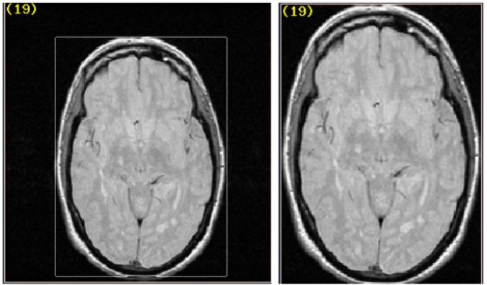
Pre-Processing the Image Dataset
Dropping all the blur images.
Region of Interest
Filtering & Smoothing an image.
Getting the Region of Interest / Volume of Interest.

Slide 11
Comparative Study for Textual Dataset
Pima Indian Diabetes Database / Dataset
Originally from the National Institute of Diabetes and Kidney Diseases
Published by UCI Machine Learning
Dataset Fields : Pregnancies, Glucose BloodPressure), SkinThickness, Insulin, BMI, DiabetesPedigreeFunction, Age, Outcome

Slide 12
Comparative Study for Textual Dataset
MODEL | ACCURACY
Logistic Regression | 0.8246753246753247
K-Nearest Neighbour Classifier | 0.7987012987012987
Support Vector Classifier | 0.8246753246753247
Naïve Bayes | 0.7922077922077922
Decision Tree Classifier | 0.7077922077922078
Random Forest Classifier | 0.8246753246753247
Artificial Neural Network | 0.7077922224998474

Slide 13
Study for Image Dataset
Convolutional Neural Network (CNN) will be used.
Datasets Acquired : Skin Cancer Detection, Breast Cancer Detection, Parkinson Disease, and many more

Slide 14
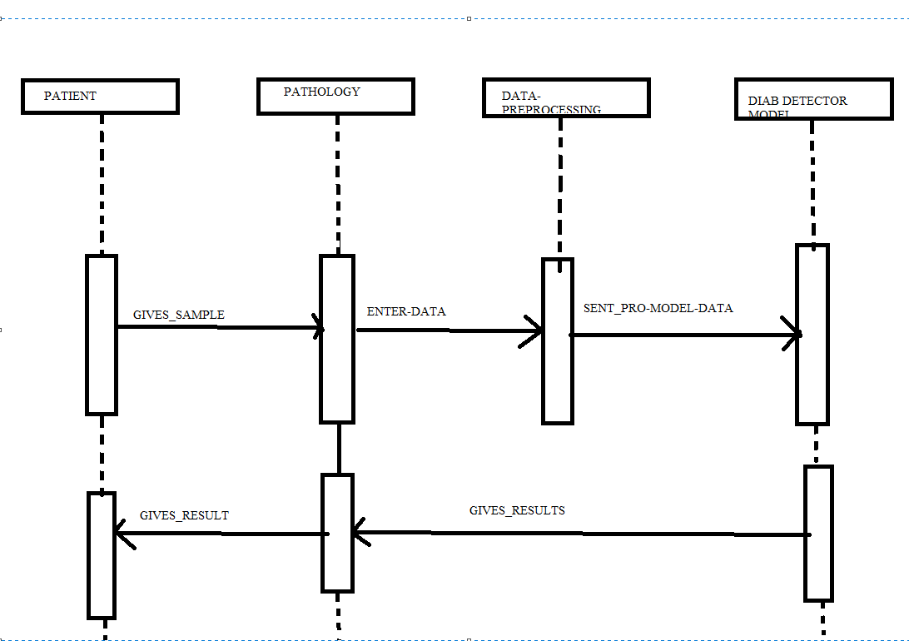
Flow Of Events

Slide 15
GUI Design
Web-Based System
Tools suitable for design.
Advantage over other tools.

Slide 16
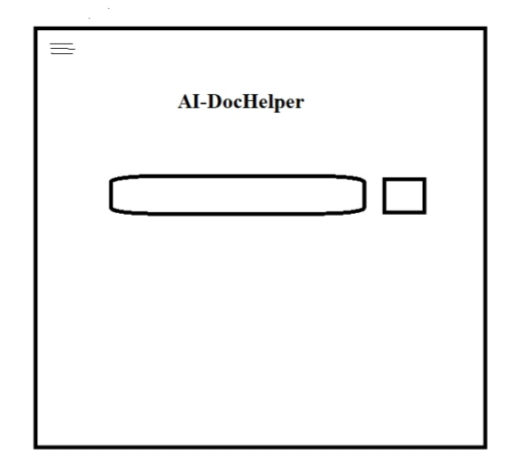
GUI Design : Default / First Page
Authentication
Search for particular disease

Slide 17
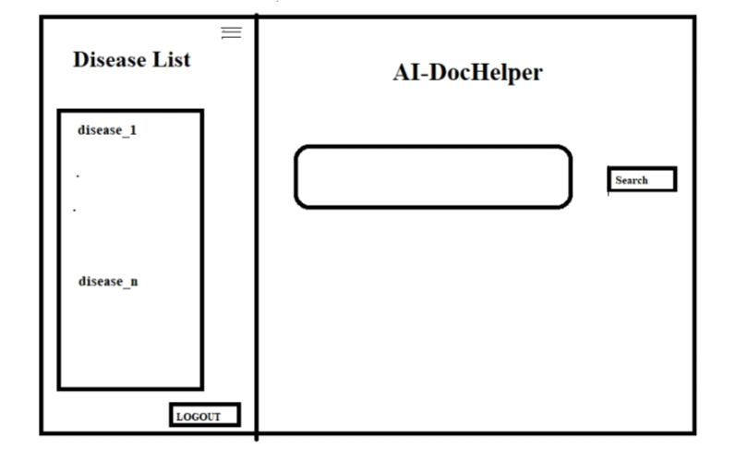
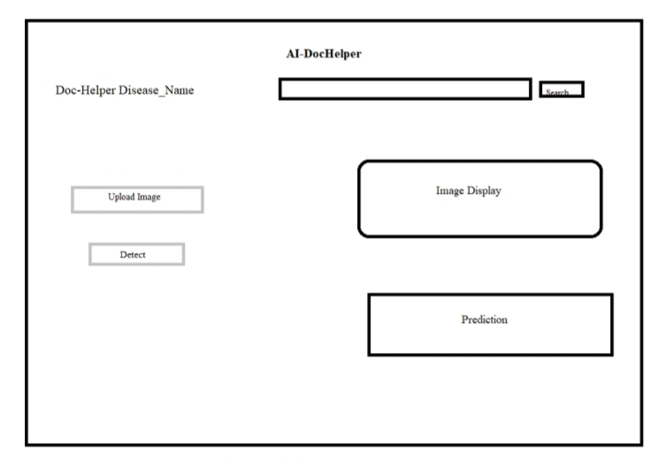
GUI Design : on Navigating
User are free to select particular disease from different options.
On selecting, Image/text data is required for result.
Once data is entered ,result is predicted on same page.

Slide 18
References
R. Sangeetha and K. S. Murthy, "A novel approach for detection of breast cancer at an early stage using digital image processing techniques," 2017 International Conference on Inventive Systems and Control (ICISC), Coimbatore, 2017, pp. 1-4, doi: 10.1109/ICISC.2017.8068625.
Y. Lu, J. Li, Y. Su and A. Liu, "A Review of Breast Cancer Detection in Medical Images," 2018 IEEE Visual Communications and Image Processing (VCIP), Taichung, Taiwan, 2018, pp. 1-4, doi: 10.1109/VCIP.2018.8698732.
S. Nayak, S. Kumar and M. Jangid, "Malaria Detection Using Multiple Deep Learning Approaches," 2019 2nd International Conference on Intelligent Communication and Computational Techniques (ICCT), Jaipur, India, 2019, pp. 292-297, doi: 10.1109/ICCT46177.2019.8969046.
X. Zeng, H. Chen, Y. Luo and W. Ye, "Automated Diabetic Retinopathy Detection Based on Binocular Siamese-Like Convolutional Neural Network," in IEEE Access, vol. 7, pp. 30744-30753, 2019, doi: 10.1109/ACCESS.2019.2903171.
T. J. Wroge, Y. Özkanca, C. Demiroglu, D. Si, D. C. Atkins and R. H. Ghomi, "Parkinson’s Disease Diagnosis Using Machine Learning and Voice," 2018 IEEE Signal Processing in Medicine and Biology Symposium (SPMB), Philadelphia, PA, 2018, pp. 1-7, doi: 10.1109/SPMB.2018.8615607.
Y. Liu et al., "Detecting Diseases by Human-Physiological-Parameter-Based Deep Learning," in IEEE Access, vol. 7, pp. 22002-22010, 2019, doi: 10.1109/ACCESS.2019.2893877.
A. Shrivastava, I. Jaggi, S. Gupta and D. Gupta, "Handwritten Digit Recognition Using Machine Learning: A Review," 2019 2nd International Conference on Power Energy, Environment and Intelligent Control (PEEIC), Greater Noida, India, 2019, pp. 322-326, doi: 10.1109/PEEIC47157.2019.8976601.

Slide 19
Thank You

